Slide 1
Introduction to Python for data scientists
workshop, 20.08.2019

Slide 2
Slides and files
https://drive.google.com/drive/folders/1xCaSxCaxO4hig8uh47prJpGpgCgn1eT-?usp=sharing

Slide 3
Goals
Have a working Python environment set up
Be able to run Python code
Know basic syntax / know where to look for help
Be able to install and use new packages
Have Jupyter set up
Load, save and manipulate tabular data in Python
Calculate using data, plot results

Slide 4
Agenda
10 min Introduction
80 min Basic Python syntax with exercises
10 min Break
10 min Modules & packages
20 min Jupyter
60 min Introduction to data analysis with Pandas
10 min Break
Remaining time: Final exercise, questions

Slide 5
Introduction

Slide 6
Data science?
software development
data science
mobile apps, websites, business software, robots, autonomous cars, crypto currencies, satellites, nuclear plants teams of professional developers
thousands of lines of code
project management, release dates, leanagilescrum
requirements
software design, architecture, patterns, styles
clients, users
result: tested, working, re-usable, safe code
data analysis, statistics, simulations, physical, mathematical computations
scientist(s), co-authors
as few lines of code as possible
project management !?
problems, ideas, data
exploration
scientific community
result: (reproducible) findings

Slide 7


Data science
data science
easy to learn
quick results
reliable results
easy to share
reproducible
data analysis, statistics, simulations, physical, mathematical computations
scientist(s), co-authors
as few lines of code as possible
project management !?
problems, ideas, data
exploration
scientific community
result: (reproducible) findings

Slide 8

What is Python?
“Python is an interpreted, object-oriented, high-level programming language with dynamic semantics.”
Invented in the 90s by Guido van Rossum (NL)
Free / Open Source
Has become de-facto standard for data science (along with other languages and tools…)

Slide 9
Python is simple
Easy to learn, quick to get results with
Intuitive syntax, readable code
Hard to break
Runs on every major platform (windows, macOS, linux etc.)
Huge offer of packages (“add-ons”) to choose from (most problems are already solved)
Well-tried in professional software development
Large active community, many tutorials etc.

Slide 10
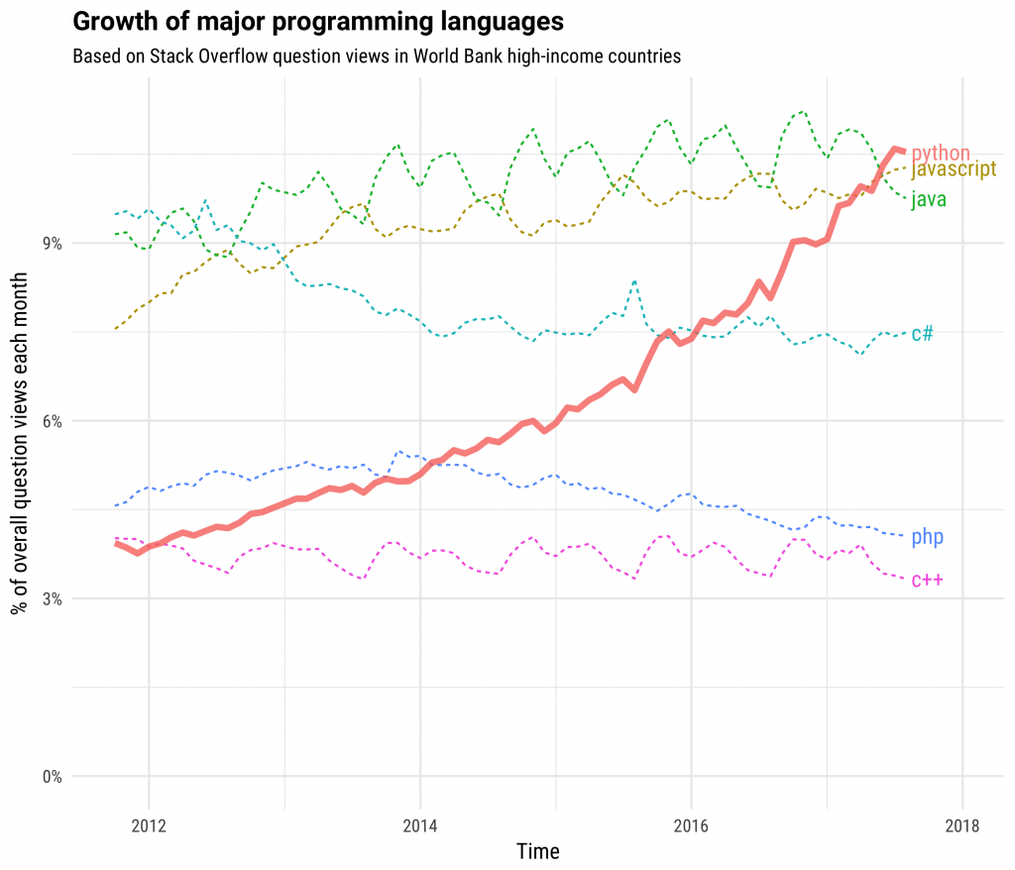
Python is trendy

Slide 11
















Everybody is using Python
https://wiki.python.org/moin/OrganizationsUsingPython
https://www.fullstackpython.com/companies-using-python.html

Slide 12
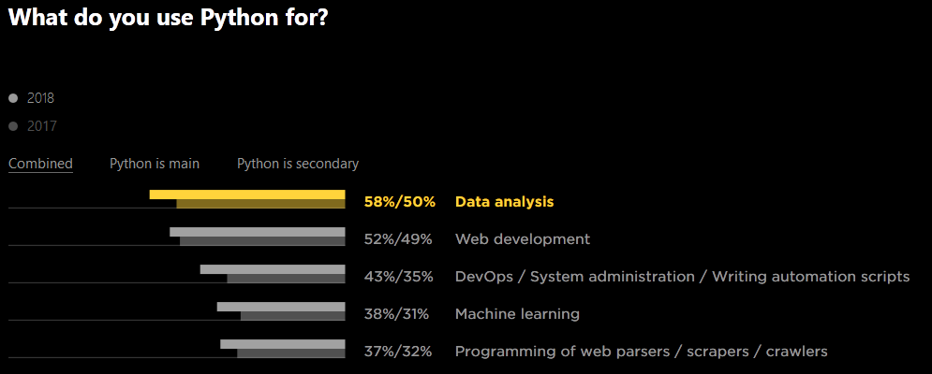
Python: de-facto standard for data analysis
KDnuggets Software Poll (n>1,800)
Platform | 2019 % share | 2018 % share | % change
Python | 65.8% | 65.6% | 0.2%
R Language | 46.6% | 48.5% | -4.0%
SQL Language | 32.8% | 39.6% | -17.2%
Java | 12.4% | 15.1% | -17.7%
Unix shell/awk | 7.9% | 9.2% | -13.4%
C/C++ | 7.1% | 6.8% | 3.7%
Javascript | 6.8% | na | na
Other programming and data languages | 5.7% | 6.9% | -17.1%
Scala | 3.5% | 5.9% | -41.0%
Julia | 1.7% | 0.7% | 150.4%
Perl | 1.3% | 1.0% | 25.2%
https://www.jetbrains.com/research/python-developers-survey-2018/
https://www.kdnuggets.com/2019/05/poll-top-data-science-machine-learning-platforms.html

Slide 13
Running python
Interactive mode: Running code in the console. On Windows: ⊞ win + R → “cmd” → ipython
Scripts: Executing a python-script (filenames with .py extension) → console: python filename.py
Notebooks: Running code in a “notebook”, e.g. Jupyter
Exercise (2 mins):
Start Python in interactive mode

Slide 14
Python syntax

Slide 15
Python syntax
Variables: x = 1 + 2
Basic blocks: =, ==, >, <, >=, <=, !=, not, and, or, (, )
Each line is a command
# comments will not be executed
x = 1 + 2 # anything after “#” is a comment
Python3 supports Unicode: ⻇ = 1 + 2
use print(…) to output expressions

Slide 16
Python syntax: Basic types & operations
None type
Booleans: True, False
Numbers: int (-1, 0, 1, …) float (-1.1283, …) , complex (…)
Text: str (“this is a text”, ‘this is a text’)
Sequences / sets:
list: [0, 1, 2], [‘a’, ‘b’, 1], [True, False], [ ] tuple: (0, 1, 2), (‘a’, ‘b’, 1) set: {0, 1, 2}, {True, ‘a’, 1}, {‘a’, 1, ‘a’}
Maps:
map { ‘a’: 0.284, ‘b’: True, 1: “xy” }
https://docs.python.org/3/library/stdtypes.html

Slide 17
Python syntax: Booleans
True, False # case sensitive!
x = True
y = False
x or y # True
x and y # False
not x # False
not y # True
not ( x and y ) # True
https://docs.python.org/3/library/stdtypes.html#boolean-operations-and-or-not

Slide 18
Python syntax: Numbers
Operation | Result
x + y | sum of x and y
x - y | difference of x and y
x * y | product of x and y
x / y | quotient of x and y
x % y | remainder of x / y
-x | x negated
+x | x unchanged
abs(x) | absolute value or magnitude of x
int(x) | x converted to integer
float(x) | x converted to floating point
pow(x, y) | x to the power y
x ** y | x to the power y
https://docs.python.org/3/library/stdtypes.html#numeric-types-int-float-complex

Slide 19
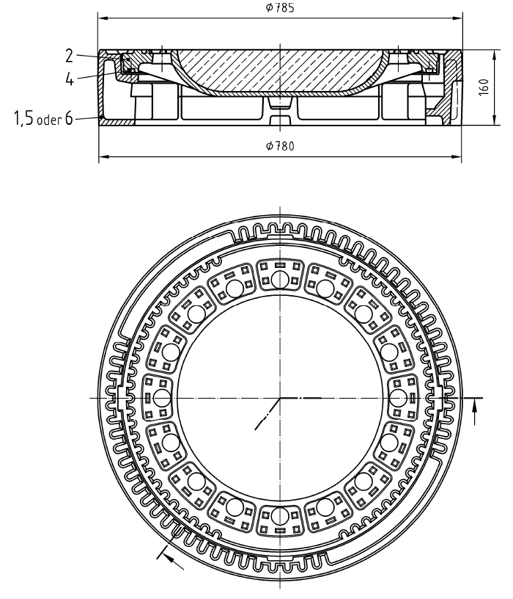

Python syntax: Numbers
Exercise (5 mins):
What is the area (in m²) of this DIN 19584 — A — D 400 manhole cover? Hints: π ≈ 3.14, r = 0.5 * 785 mm
DIN 19584-1:2012-10
https://docs.python.org/3/library/stdtypes.html#numeric-types-int-float-complex

Slide 20
Python syntax: strings
x = “FG INNO”
len(x) # 7
“I” in x # True
x.count(“N”) # 2
x[1] # G
x = x + “ is great” # x = “FG INNO is great”
y = “!!!”
x + y # “FG INNO is great!!!”
“You can insert new lines \n and tabs \t etc.”
https://docs.python.org/3/library/stdtypes.html#sequence-types-list-tuple-range

Slide 21
Python syntax: lists
x = [1, 5, 7, 3, 5, 9]
len(x) # 6
sum(x) # 30
max(x) # 9
3 in x # True
x.count(5) # 2
x.sort() # x = [1, 3, 5, 5, 7, 9]
x + [10, 11] # [1, 3, 5, 5, 7, 9, 10, 11]
https://docs.python.org/3/library/stdtypes.html#sequence-types-list-tuple-range

Slide 22
Python syntax: tuples & sets
Quiz
What is
(a) len( set( [1,1,2,2,3,3] ) )
(b) (2,1,3).sort() ?
https://docs.python.org/3/library/stdtypes.html#sequence-types-list-tuple-range

Slide 23
Python syntax: list slicing
list[start:stop:step]
x = [“DIN”, “ISO”, “DIN”, “ETSI”, “IETF”]
x[1:3] # [“ISO”, “DIN”, “ETSI”]
x[3:] # [“ETSI”, “IETF”]
x[:1] # [“DIN”, “ISO”]
x[:-3] # [“DIN”, “ISO”]
x[1:4:2] # [“ISO”,”ETSI”]
https://docs.python.org/3/library/stdtypes.html#sequence-types-list-tuple-range

Slide 24
Python syntax: list comprehension
Create a list by giving a functional definition of the elements
x = [i for i in range(1,5)] # [1,2,3,4]
y = [a/2 for a in range(0,3)] # [0, 0.5, 1]
z = [(n, 2*n) for n in y] # [(0,0), (0.5, 1), (1,2)]
z_1 = [(n, 2*n) for n in y if n<1] # [(0,0), (0.5, 1)]
z_2 = [(n, 2*n) for n in y][::2] # [(0,0), (1, 2)]
https://docs.python.org/3/tutorial/datastructures.html#list-comprehensions

Slide 25
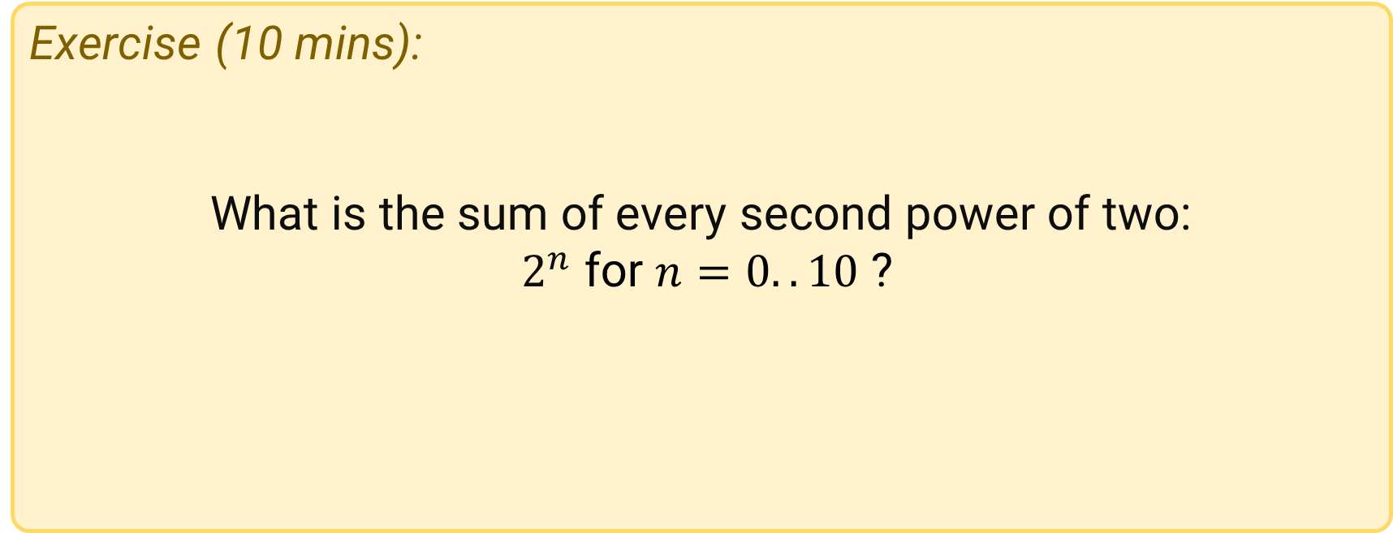
Python syntax: lists
Exercise (10 mins):
What is the sum of every second power of two:
$2^{n}$ for $n=0..10$ ?
https://docs.python.org/3/tutorial/datastructures.html#list-comprehensions

Slide 26
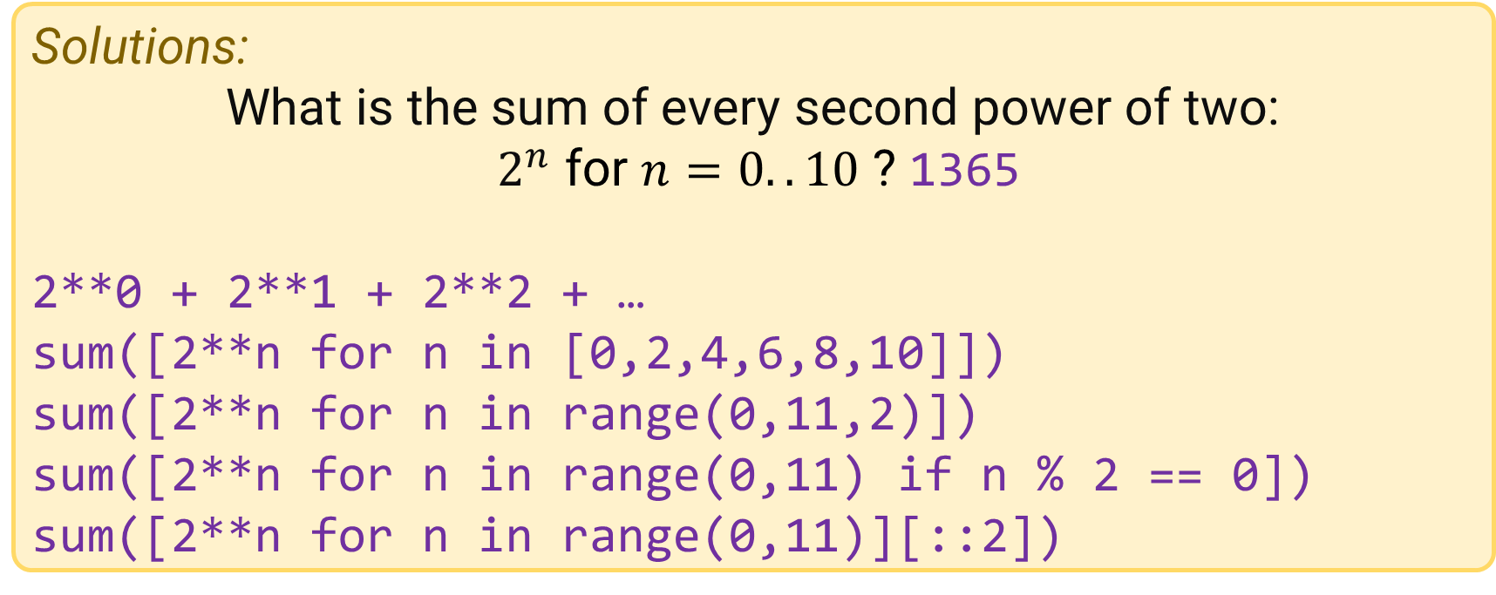
Python syntax: lists
Solutions:
What is the sum of every second power of two:
$2^{n}$ for $n=0..10$ ? 1365
2**0 + 2**1 + 2**2 + …
sum([2**n for n in [0,2,4,6,8,10]])
sum([2**n for n in range(0,11,2)])
sum([2**n for n in range(0,11) if n % 2 == 0])
sum([2**n for n in range(0,11)][::2])
https://docs.python.org/3/tutorial/datastructures.html#list-comprehensions

Slide 27
Python syntax: maps
map = { key1: value1, key2: value2} # keys are unique
map[key] # value
levels = { “DIN”: “DE”, “DKE”: “DE”, “CEN”: “EU”, “CENELEC”: “EU”}
level[“DIN”] # DE
level[“ETSI”] = “EU”
level.keys() # DIN, DKE, CEN, CENELEC
Level.values() # DE, DE, EU, EU
x = {i: i**2 for i in range(2,6)} # {2:4, 3:9, 4:16, 5:25}
https://docs.python.org/3/tutorial/datastructures.html#dictionaries

Slide 28
Python syntax: control flows
The usual suspects: if, else, while, for
Inside these constructs, statements are intended (e.g. with a tab):
if x > 5:
print(“x is too big”)
x = 5
else:
print(“x is ok”)
https://docs.python.org/3/tutorial/controlflow.html

Slide 29
Python syntax: if, else, elif
if x > 5:
print(“x is too big”)
elif x < 2:
print(“x is too small”)
else:
print(“x is ok”)
s = “negative” if x < 0 else “positive”
https://docs.python.org/3/tutorial/controlflow.html#if-statements

Slide 30
Python syntax: while
Execute code as long as an expression is True
x = 0
while x < 10:
print(x)
x = x + 1
# 0 1 2 3 4 5 6 7 8 9
https://docs.python.org/3/tutorial/controlflow.html

Slide 31
Python syntax: for
Same as in list comprehensions, used to iterate over a sequence of items
for x in range(10):
print(x)
for x in [i for i in range(10) if i % 2 == 0]:
print(x)
for w in “an example sentence”.split(“ “):
print(w)
https://docs.python.org/3/tutorial/controlflow.html#for-statements

Slide 32
Python syntax: control flow
Exercise (15 mins):
How many prime numbers are < 100?
https://docs.python.org/3/tutorial/controlflow.html

Slide 33
Python syntax: control flow
Exercise (15 mins): How many prime numbers are < 100?
count = 0
# look at all numbers n from 2 – 100:
for n in range(2,101):
is_prime = True
# if n can be divided by any number x<n, it’s not a prime number
for x in range(2, n):
if n % x == 0:
is_prime = False
break
if is_prime:
count += 1
print(count)
https://docs.python.org/3/tutorial/controlflow.html

Slide 34
Python syntax: control flow
primes = []
# look at all numbers n from 2 – 100:
for n in range(2,101):
is_prime = True
# if n can be divided by any number 2>n>x, it’s not a prime number
for x in range(2, n):
if n % x == 0:
is_prime = False
break
if is_prime:
primes.add(n)
print(len(primes))
print(primes)
https://docs.python.org/3/tutorial/controlflow.html

Slide 35
Python syntax: control flow
An example for a list comprehension solution
any(list): True if any element of list is True
Pro: short & concise
Contra: less easy to read, less optimized (missing break)
primes = [n for n in range(2, 101) if not any([n % x == 0 for x in range(2, n))]
print(len(primes))
print(primes)
https://docs.python.org/3/tutorial/controlflow.html

Slide 36
Python syntax: functions
Re-usable code blocks with parameters
# a function that returns all prime numbers < limit
def primes(limit):
p = [n for n in range(2, limit + 1)
if not any([n % x == 0 for x in range(2, n))]
return p
print(primes(1000))
print(373 in primes(400))
https://docs.python.org/3/tutorial/controlflow.html#defining-functions

Slide 37
Python syntax: functions
def function_name(x, y, z):
…
# parameters be optional and can have default values
def f(x, y, z=5):
return x+y+z
f(1,2) # 8
f(1,2,3) # 6
f(y=2, x=1, z=3) # 6
https://docs.python.org/3/tutorial/controlflow.html#default-argument-values

Slide 38
Python syntax: (parameter) unpacking
a, b, c, d = [1, 2, 3, 4] # a=1, b=2, …
def f(x, y, z):
return [x+y, z]
a, b = f(1,2,3) # a=3, b=3
f(*[1,2,3]) == f(1,2,3) # True, pass parameters as a list
f(*(1,2,3)) # … a tuple
f(**{‘x’: 1, ‘z’: 3, ‘y’: 2}) # … or named as a map
https://docs.python.org/3/tutorial/controlflow.html#unpacking-argument-lists

Slide 39
Python syntax: (parameter) unpacking
import math
# example: transformation from cartesian to spherical coordinates
def spherical(x, y, z):
r = math.sqrt(x**2 + y**2 + z**2)
phi = math.arctan(y/x)
theta = math.arccos(z/r)
return (r, theta, phi)
# some_object.coordinates() = (x, y, z)
r, phi, theta = spherical(*some_object.coordinates())
https://docs.python.org/3/tutorial/controlflow.html#unpacking-argument-lists

Slide 40
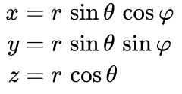
Python syntax: functions
Exercise (10 mins):
Write a function that transforms spherical coordinates to cartesian coordinates: (r, theta, phi) → (x, y, z)
Hint: Use import math to load the math module, and the math.sin(x) and math.cos(x) functions.
https://docs.python.org/3/tutorial/controlflow.html - https://docs.python.org/3/library/math.html

Slide 41
Python syntax: functions
import math
def cartesian(r, theta, phi):
x = r * math.sin(theta) * math.cos(phi)
y = r * math.sin(theta) * math.cos(phi)
z = r * math.cos(theta)
return (x, y, z)
coords = (1.5, 90, 180)
cartesian(*(coords))
https://docs.python.org/3/tutorial/controlflow.html - https://docs.python.org/3/library/math.html

Slide 42
Python syntax: functions
Quiz
How would you output just the resulting y of cartesian(*(coords)) ?
https://docs.python.org/3/tutorial/controlflow.html - https://docs.python.org/3/library/math.html

Slide 43
Python syntax: lambda expressions
def plus(x, y):
return x + y
plus(1,2) # 3
minus = lambda x,y: x - y
minus(3,1) # 2
map( lambda x: x**2 + (x/2), [1,2,3,4] )
# [1.5, 5.0, 10.5, 18.0]
https://docs.python.org/3/reference/expressions.html#lambda

Slide 44
10 min break

Slide 45
modules & packages

Slide 46
Python syntax: Modules
import math
import math as m
from math import cos
from math import sin, pi
from math import pi as π
math.sin(0)
m.sin(0)
cos(0)
sin(0)
print(pi)
print(π)
https://docs.python.org/3/tutorial/modules.html#modules

Slide 47
Modules & packages
Default modules that are always included in Python: https://docs.python.org/3/library/index.html. Examples:
math – mathematical functions
time — time access and conversions
random — generate pseudo-random numbers
Packages (contain modules), open source, listed on https://pypi.org. Currently ~190,000 projects. Examples:
Numpy – (fast) scientific computing with Python
Pandas – data analysis library
TensorFlow – machine learning
Scikit-Learn – machine learning
If you are using the Anaconda distribution, a lot of packages will already be installed!
https://docs.python.org/3/tutorial/modules.html#modules

Slide 48
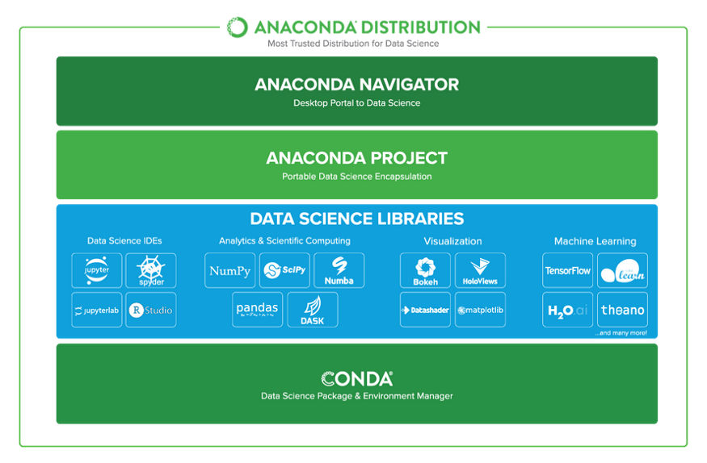
Modules & packages
https://docs.anaconda.com/anaconda/packages/py3.7_win-64/

Slide 49
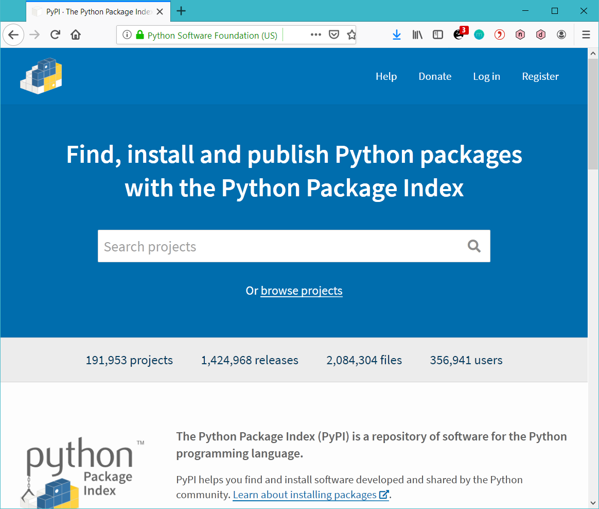
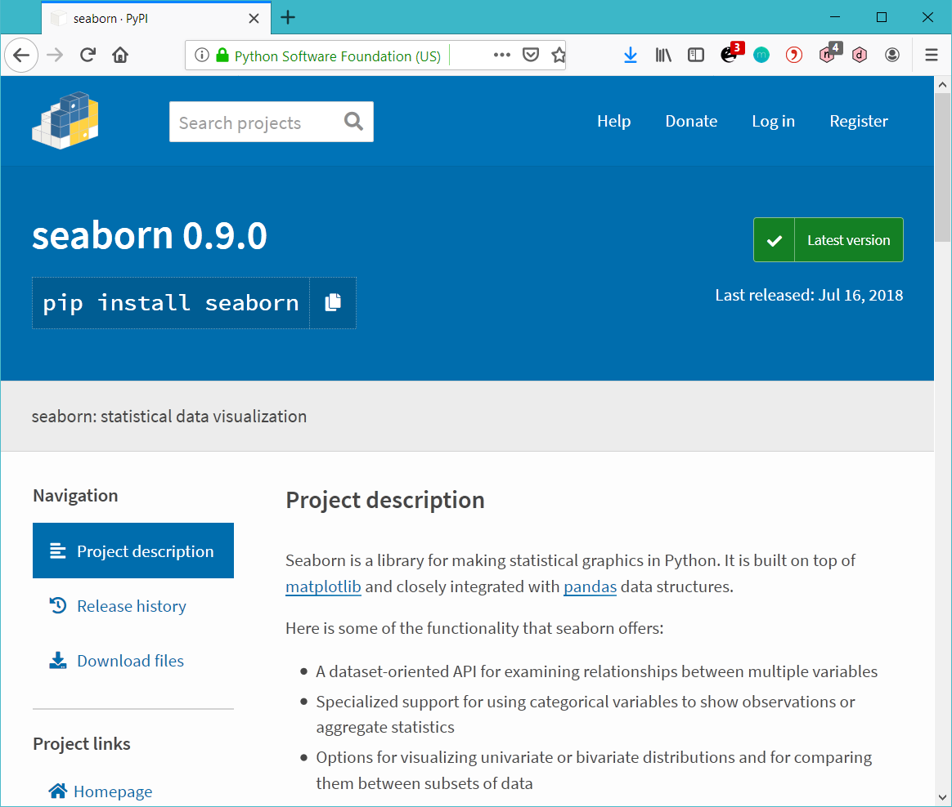
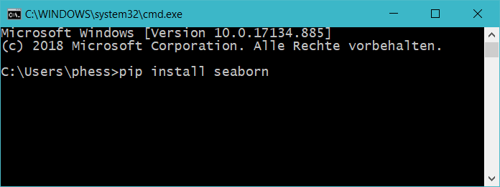
Modules & packages
https://docs.python.org/3/tutorial/modules.html#modules

Slide 50
Modules & packages
import seaborn as sns
# some magic so the plot will be shown when produced in the console
%matplotlib qt
# Load an example dataset with long-form data
d = sns.load_dataset("fmri")
# Plot
sns.lineplot(x="timepoint", y="signal",
hue="region", style="event", data=d)
https://seaborn.pydata.org/examples/errorband_lineplots.html

Slide 51
Jupyter

Slide 52
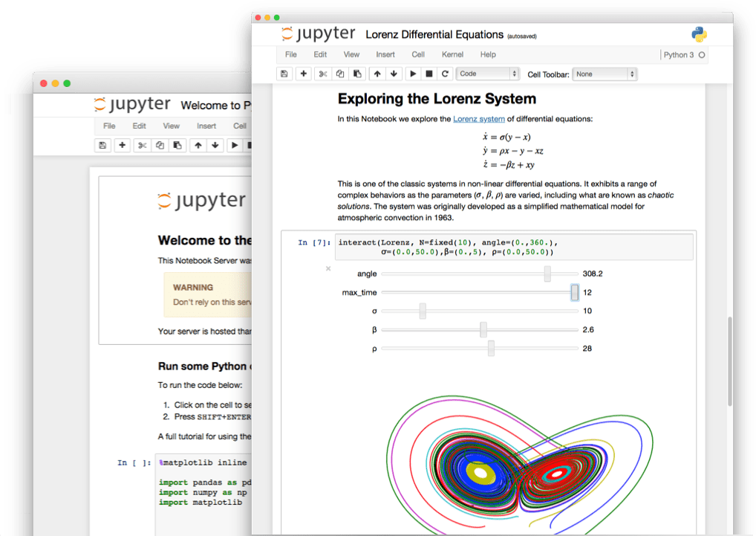


Jupyter
Write Python code in a “notebook” in your browser
Output is included in the notebook
Easy to share notebooks
Python
https://jupyter.org/

Slide 53
Jupyter notebooks
jupyter_examples.ipynb

Slide 54
Running python
Interactive mode: Running code in the console. On Windows: ⊞ win + R → “cmd” → ipython
Scripts: Executing a python-script (filenames with .py extension) → console: python filename.py
Notebooks: Running code in a “notebook”, e.g. Jupyter
Exercise (2 mins):
Start Jupyter: ⊞ win → “Jupyter” → enter

Slide 55
Jupyter notebooks
Exercise (20 mins):
Create a new Jupyter notebook called „<your name>“ on your desktop.
Copy and run one of the plotting examples from https://seaborn.pydata.org/examples/index.html
Upload your notebook to the cloud at https://tubcloud.tu-berlin.de/s/yXken8P3toea5XR
Look at and run some of the others’ examples
https://jupyter-notebook.readthedocs.io/en/stable/

Slide 56
Introduction to data analysis with Pandas

Slide 57
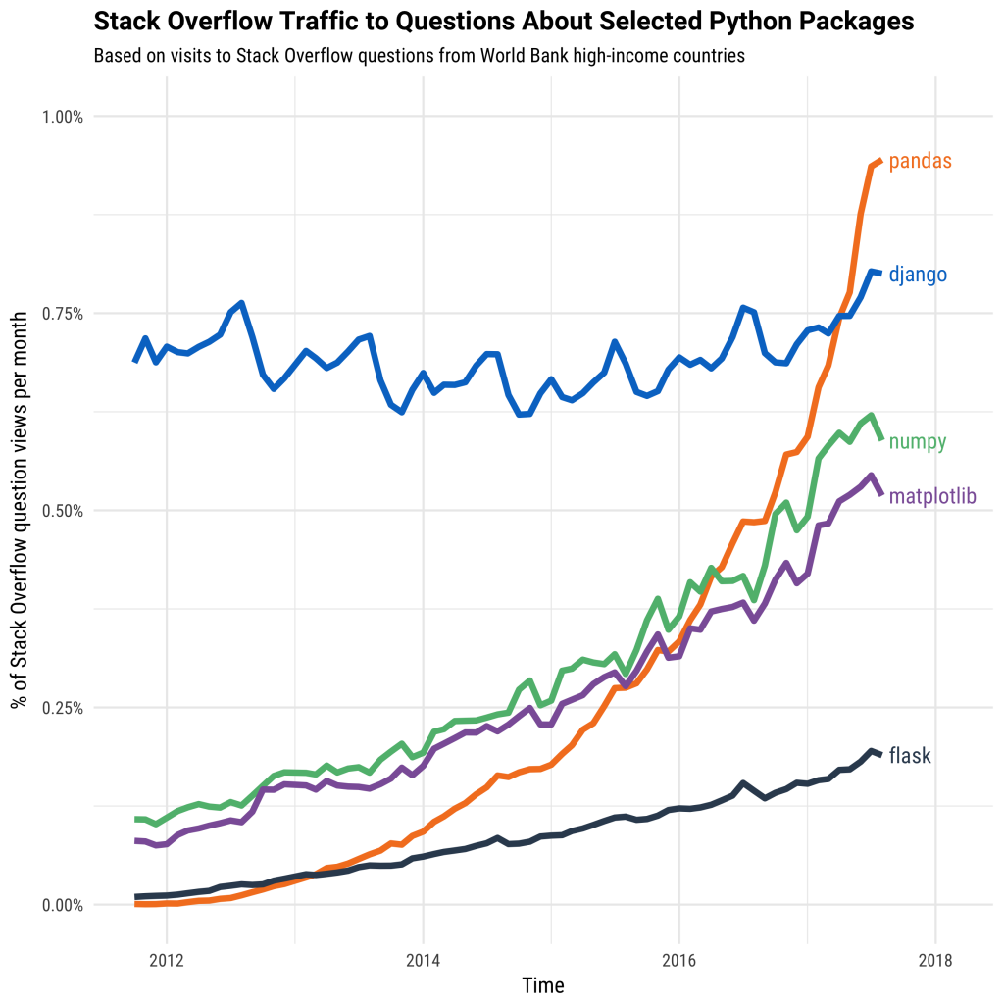

Pandas
Part of the Anaconda distribution
The “Excel”, “R data.tables” of Python
Easy loading / saving / manipulation of tabular data
Integrated easy plotting
Querying data
Support for time series
…
https://pandas.pydata.org/

Slide 58
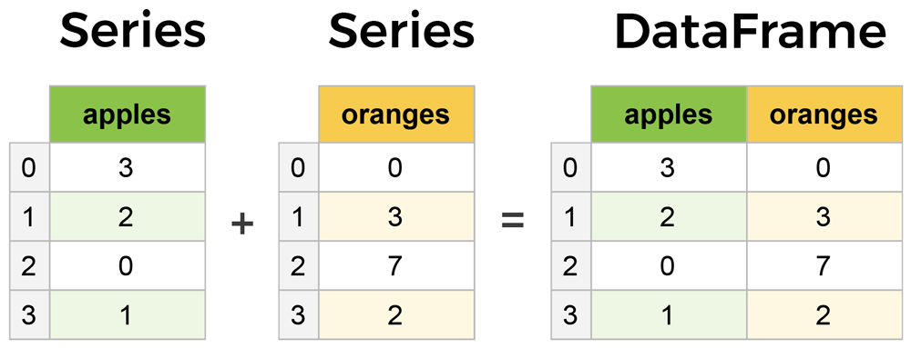
Pandas: DataFrame, Series
Core classes: DataFrame and Series
Series: An ordered, indexed sequence of arbitrary values (numbers, strings, dates, ….)
DataFrame: A two dimensional datatype with rows, columns and an index – a table. Or: a collection of Series (columns) with the same index

Slide 59
Pandas
Creating and exploring a dataset
Indexing: Selecting a certain data item from a Series, or a data item or sequence of data items from a DataFrame
Aggregation: Running functions on sequences of data items
Grouping
Selection: Selecting items/sequences using logic
Plotting
https://pandas.pydata.org/pandas-docs/stable/user_guide/index.html

Slide 60
Pandas
pandas_intro.ipynb

Slide 61
Pandas: Series
Exercise (10 mins):
Generate a random Series that is correlated (>= 0.5) to the prime numbers below 100
https://pandas.pydata.org/pandas-docs/stable/reference/api/pandas.Series.html

Slide 62
Pandas: Series
Exercise (10 mins): Generate a random Series that is correlated (>= 0.5) to the prime numbers below 100
corr = -1
r = None
while corr < 0.6:
r = pd.Series(random.sample(range(1, 100), 25), index=primes.index)
corr = primes.corr(r)
r.plot(title="correlation = " + str(corr))
primes.plot()
https://pandas.pydata.org/pandas-docs/stable/reference/api/pandas.Series.html

Slide 63
Pandas: indexing Series
index
0 | 0
1 | 1
2 | 2
3 | 3
4 | 4
Series → Value (1d)
s1 = Series(range(5))
s1[2] # 2
s2 = Series(
range(5), index=[‘A’, ‘B’, ‘C’, ‘D’, ‘E’]
)
s2[‘D’] # 3
index
A | 0
B | 1
C | 2
D | 3
E | 4

Slide 64
Pandas: indexing DataFrames
DataFrame → Series (2d) / Value (1d)
df = DataFrame({
‘a’: range(5),
‘b’: range(2,7)
}) df[‘b’] # 2 3 4 5 6 (column)
df.iloc[0] # 0 2 (row)
df.iloc[1,1] # 3 (value)
df.iloc[::2] # every second row
index | a | b
0 | 0 | 2
1 | 1 | 3
2 | 2 | 4
3 | 3 | 5
4 | 4 | 6
index | a | b
0 | 0 | 2
1 | 1 | 3
2 | 2 | 4
3 | 3 | 5
4 | 4 | 6
index | a | b
0 | 0 | 2
1 | 1 | 3
2 | 2 | 4
3 | 3 | 5
4 | 4 | 6
index | a | b
0 | 0 | 2
1 | 1 | 3
2 | 2 | 4
3 | 3 | 5
4 | 4 | 6

Slide 65
Pandas: indexing DataFrames
names or numbers
df1 = DataFrame([
range(5),
range(2,7)
]) df2 = DataFrame(
{ ‘a’: range(5),
‘b’: range(2,7),
‘C’: range(3,8) },
index=[‘A’,’B’,’C’,’D’,’E’]
)
index | 0 | 1
0 | 0 | 2
1 | 1 | 3
2 | 2 | 4
3 | 3 | 5
4 | 4 | 6
index | a | b | c
A | 0 | 2 | 3
B | 1 | 3 | 4
C | 2 | 4 | 5
D | 3 | 5 | 6
E | 4 | 6 | 7

Slide 66
Pandas: indexing DataFrames
names or numbers
df1[0] # first column
df1.iloc[0] # first row
df1.iloc[0,1] # row=0, col=1
df1.iloc[::2,1] # every second item of col=1
df2[‘a’]
df2[[‘a’,’c’]]
df2.loc[‘A’] == df2.iloc[0] # True
df2.loc[[‘C’,’E’],[‘a’,’b’]] # 2 4
# 4 6
index | 0 | 1
0 | 0 | 2
1 | 1 | 3
2 | 2 | 4
3 | 3 | 5
4 | 4 | 6
index | a | b | c
A | 0 | 2 | 3
B | 1 | 3 | 4
C | 2 | 4 | 5
D | 3 | 5 | 6
E | 4 | 6 | 7

Slide 67
Pandas: aggregating DataFrames
Series → Value (1d): Series(range(5)).sum() # 10
DataFrame → Series (2d) / Value (1d)
df2[‘a’].sum() # 10
df2.sum() # 10 20 25
df2[‘A’].sum() # 5
df2.sum(axis=1) # 5 8 11 14 17
df2.sum().sum() # 55
axis=1
index | a | b | c | SUM
A | 0 | 2 | 3 | 5
B | 1 | 3 | 4 | 8
C | 2 | 4 | 5 | 11
D | 3 | 5 | 6 | 14
E | 4 | 6 | 7 | 17
SUM | 10 | 20 | 25 | 55
axis=0
default
Other common aggregations: mean, median, mode, max, min, var, std
https://pandas.pydata.org/pandas-docs/stable/reference/frame.html#computations-descriptive-stats

Slide 68
Pandas: aggregating DataFrames
Compute any aggregation:
df2.aggregate(numpy.sum) # == df2.sum()
df2.aggregate(numpy.sum, axis=1) # == df2.sum(axis=1)
df2.aggregate(numpy.log) # 5x3 df with log(item)
df2.aggregate([numpy.sum, numpy.mean, numpy.std])
df2.aggregate(lambda x: x**2 + x)
https://pandas.pydata.org/pandas-docs/stable/reference/frame.html#computations-descriptive-stats

Slide 69
Pandas: aggregating DataFrames
Custom aggregations on axes
# aggregate each column with A - E
df2.apply(lambda rows: (rows[‘A’] – rows[‘E’]))
# aggregate each row with a / c
df2.apply(lambda cols: (cols[‘a’]/cols’[c’]), axis=1)
https://pandas.pydata.org/pandas-docs/stable/reference/frame.html#computations-descriptive-stats

Slide 70
Pandas: DataFrame transposition
df2.T
index | a | b | c
A | 0 | 2 | 3
B | 1 | 3 | 4
C | 2 | 4 | 5
D | 3 | 5 | 6
E | 4 | 6 | 7
index | A | B | C | D | E
a | 0 | 1 | 2 | 3 | 4
b | 2 | 3 | 4 | 5 | 6
c | 3 | 4 | 5 | 6 | 7
https://pandas.pydata.org/pandas-docs/stable/reference/api/pandas.DataFrame.transpose.html

Slide 71
Pandas: DataFrame indexing & aggregation
Exercise (10 mins, choose one):
Get all 2019 innovation expenditures of sectors with numbers starting with “C“
Get the innovation expenditures of “C 26” from 2010 to 2019
Imagine that data was corrupted in every 2nd year. Use only the 1st, 3rd, … year to calculate mean expenditures.
Calculate the average change in expenditures since 2006 for sectors “C ..”
https://pandas.pydata.org/pandas-docs/stable/user_guide/indexing.html

Slide 72
Pandas: DataFrame indexing & aggregation
inno_num.loc[
"2019", [c for c in inno_num.columns if c[0]=="C"]
]
inno_num.loc[
[str(y) for y in range(2010,2020)], “C 26”
]
inno_num.loc[::2, :].mean()
inno_num[[c for c in inno_num.columns if c[0]=="C"]].apply(lambda years: (years[-1] - years[0])).mean()
https://pandas.pydata.org/pandas-docs/stable/user_guide/indexing.html

Slide 73
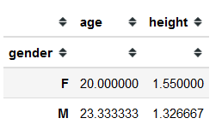
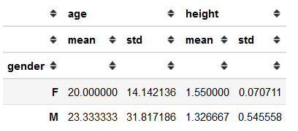
Pandas: grouping
index | gender | age | height
0 | M | 60 | 1.80
3 | M | 7 | 1.45
4 | M | 3 | 0.73
index | gender | age | height
0 | M | 60 | 1.80
1 | F | 30 | 1.60
2 | F | 10 | 1.50
3 | M | 7 | 1.45
4 | M | 3 | 0.73
dfg =
dfg.groupby(by=“gender)
dfg.groupby(by=“gender”).mean()
dfg.groupby(by="gender").aggregate([np.mean, np.std])
index | gender | age | height
1 | F | 30 | 1.60
2 | F | 10 | 1.50
https://pandas.pydata.org/pandas-docs/stable/user_guide/groupby.html

Slide 74
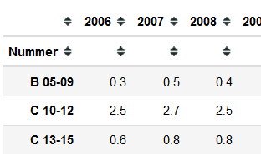
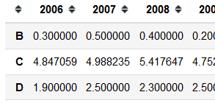
Pandas: grouping
Average expenditures per sector groups
Use index for grouping:
(inno_num.T
.groupby(by=lambda index: index[0])
.apply(np.mean))
inno_num.T
https://pandas.pydata.org/pandas-docs/stable/user_guide/groupby.html

Slide 75
10 min break

Slide 76
Introduction to Python for data scientists
Final exercise:

